Slide 1

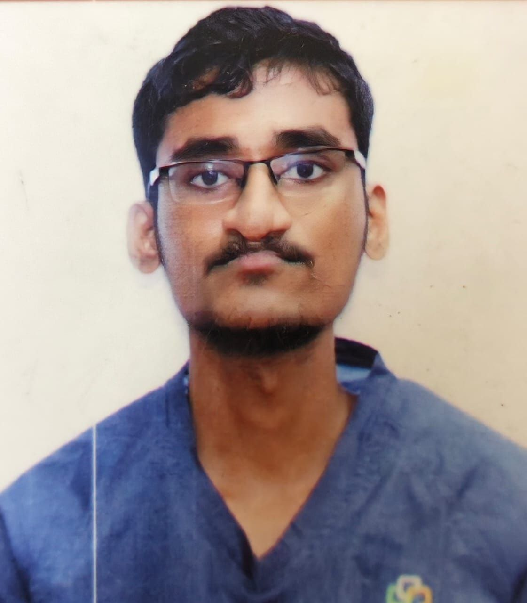
Dr. BALARAM
PROMETHEANS [2020 – 2025]
Saveetha Medical College, Saveetha Institute of Medical and Technical Sciences.

Slide 2
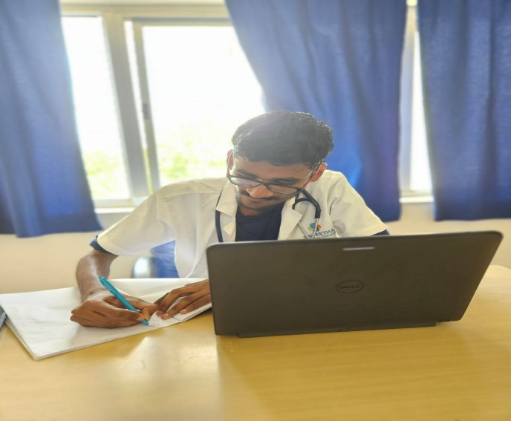
Dr. BALARAM
Bachelor of Medicine, Bachelor of Surgery
PREFACE
PROMETHEANS 2020–2025 | Saveetha Medical College Hospital
Achievements
•
Education is a ray of light in darkness. My vision is to become an academician, thereby impart the right
education and inculcate refined qualities
among the next generation students – simply like a candle
“The good physician treats the disease; the great physician treats the pa4ent who has the disease”
melting itself by providing light to shine. Teaching and demonstration sessions have never failed to amaze
me during my undergraduate program, which encouraged me to work towards becoming an academician
---William Osler
such that I hold the position of a professor/ clinical instructor.
Personal Introduction
I wanted a profession that will satisfy me, challenge me and bring me joy. I believe that a job should be like a hobby – where I want to love my work and know that I am making a diﬀerence in this world by helping others. I know it requires a tremendous amount of patience and hard work. The environment at Saveetha Medical College was simply catalytic in nature which motivated me to go extra mile in every sphere in bringing the best out of me.
•
I believe that the best way to stay mo4vated, is by visualizing one’s achievement & working hard to reach
their goal. I believe that the purpose of life is just not to be happy. it is to be useful, honorable,
compassionate and to have it make some diﬀerence that we had lived and lived well.
“The best way to ﬁnd yourself is to lose yourself in the service of others.”
— Mahatma Gandhi
“A physician is obligated to consider more than a diseased organ, more than even the whole man—he must view the man in his world.”
I am fortunate to have grown in a very compe44ve environment in my medical school which has kindled me to always keep working harder and use this freedom righteously to raise my standards as a professional and as a good human rather than be another conven4onal physician.
— Harvey Cushing

Slide 3
Phase 3B
1 |
Page
SAVEETHA MEDICAL COLLEGE HOSPITAL

Slide 4
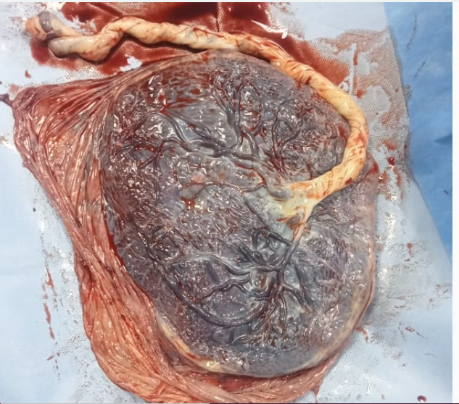
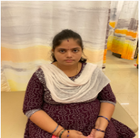
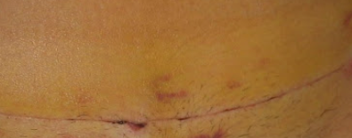
Student Name: BALARAM.S
A case of Previous LSCS
Reg. no: 112001035
S.no: 1 PID: 240305184464
Name: Arthi T Age: 22 Gender: Female
Brief Clinical History:
Chief Complaints Patient came for post op LSCS follow up
History of Presenting Illness The patient came for post op LSCS follow up. No H/O pain abdomen / leaking or bleeding PV.
No h/o headache, blurring of vision, decreased urine output, breathlessness, loose stools. No h/o burning micturition, fever or white discharge pv, vomitings.
MENSTRUAL HISTORY : RMC , 3/30 days, changes 3 pads per day , no clots or dysmenorrhea
MARITAL HISTORY : Married for 4 years x NCM
Workup:
BP-126/86mmHg,RR-16/min,Sp02-97%, pulse=82/min
General examination: Normal
Patient was consciouss and oriented to time, place and person
CVS EXAMINATION: S1S2 heard
RS EXAMINATION: NVBS
CNS: NFND, no loss of sensation
Abdomen examination: P/A-INSPECTION: Umbilicus in centre, linea nigra+, lscs scar healthy
P/A-PALPATION: Uterus contracted to 16 weeks
P/A-AUSCULTATION: Bowel sounds normal
Examination of thyroid: Normal
Examination of breast : Normal
Differential diagnosis / Clinical insights :
Uterine scar dehiscence
Necrotizing fasciitis
Peritonitis
Hemorrhage
sepsis
Management / Procedure done:
Wound dressing was done
Patient was advised to take normal diet, plenty of oral fluids
T.livogen bd,
T.calcium 500mg od
T.Vitamin-C bd
D4 INJ MAGNEX FORTE BD
NJ GENTAMICIN 80 mg IV BD
INJ PAN 40 MG IV OD
.
3 |
Page
SAVEETHA MEDICAL COLLEGE HOSPITAL

Slide 5
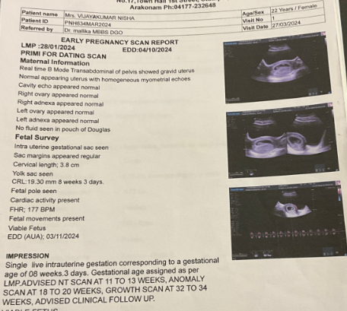
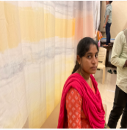
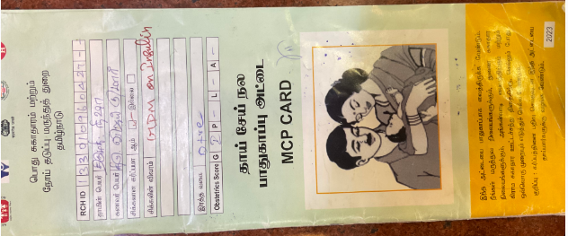
Student Name: BALARAM.S
A case of Diabetes in pregnancy
Reg. no: 112001035
S.no: 2 PID: 241014261206
Name: Nisha Panchatsharam Age: 22 Gender: Female
Brief Clinical History:
Chief Complaints : 22 yr old primigravida with 9 months of ammenorhea (38 weeks + 4days) came for regular ANC and admitted for safe confinement
History of Presenting Illness: Patient Came for regular ANC , admitted for safe confinement. Perceiving fetal movements well
No h/o abdominal pain, bleeding pv, leaking pv
Past Medical History: Gdm on insulin inj. Insulin R 2-2-2.
Personal / Family History:Personal History
consumes mixed diet, normal bowel and bladder habits, adequate sleep pattern.
Workup:
BP-110/78mmHg,RR-16/min,Sp02-97%, pulse=78/min
General examination: Pallor present
Patient was consciouss and oriented to time, place and person
CVS EXAMINATION: S1S2 heard
RS EXAMINATION: NVBS, trachea appears to be in midline
ABDOMEN EXAMINATION-:
INSPECTION SHAPE OF ABDOMEN: Longitudinally enlarged, SKIN OVER ABDOMEN: Linea Nigra,
PALPATION: FUNDAL GRIP: BREECH, RIGHT UMBILICAL GRIP: LIMB BUDS, LEFT UMBILICAL GRIP: SPINE, FIRST PELVIC GRIP: CEPHALIC
SECOND PELVIC GRIP: Unengaged
LOCAL EXAMINATION : Uterus- term, relaxed. Cephalic. Fh-145bpm
=
Examination of thyroid: Normal
Examination of breast : Normal
Differential diagnosis / Clinical insights :
Gestational diabetes mellitus
Overt diabetes
Cushing disease
Pheochromocytoma,
Management / Procedure done:
Patient was advised to take FBS, PPBS, TFT, ultrasound
FBS: 92 mg/dl; PPBS: 86 mg/dl
Diabetic diet. Adequate hydration
Tab. LIVOGEN PO OD
Tab CALCIUM 500 mg PO od
INJ HA 2U-2U-2U
CAP CANSOFT CL H/S × 5DAYS
3 |
Page
SAVEETHA MEDICAL COLLEGE HOSPITAL

Slide 6
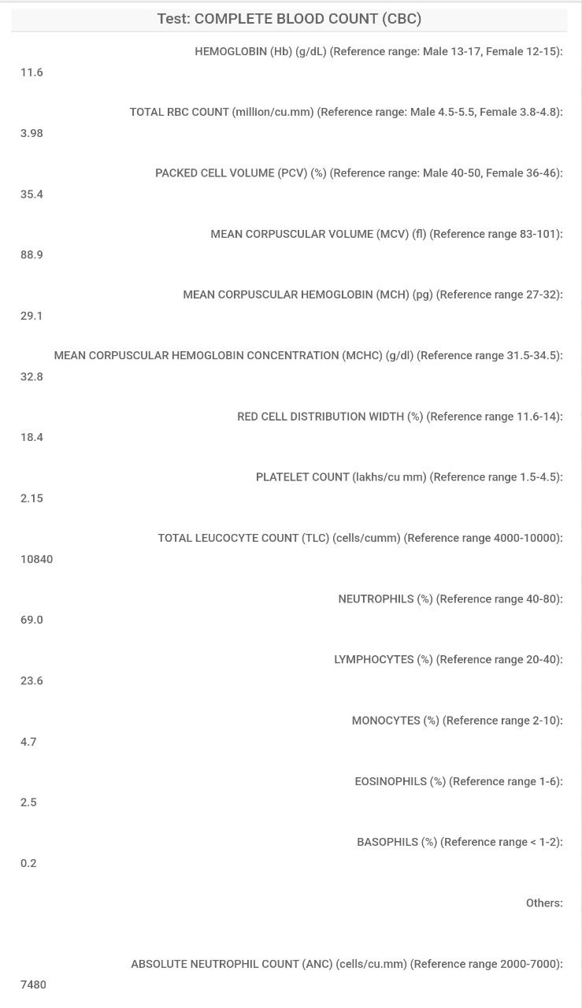
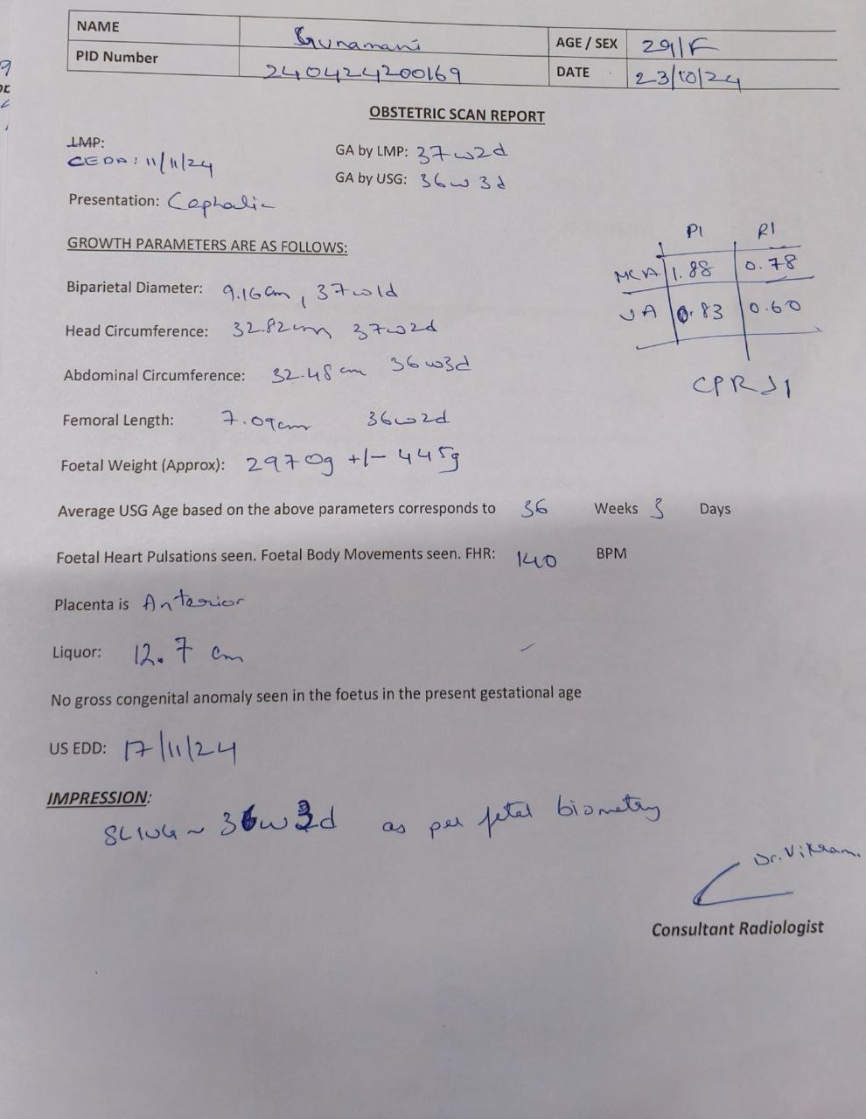
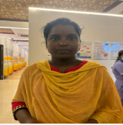
Student Name: BALARAM.S
A case of normal antenatal checkup
Reg. no: 112001035
S.no: 3 PID: 240424200169
Name: Gunamani M Age: 29 Gender: Female
Brief Clinical History:
Chief Complaints Patient Came for regular ANC , admitted for safe confinement 38 weeks + 1 day,
History of Presenting Illness: Patient Came for regular ANC , admitted for safe confinement. Perceiving fetal movements well
No h/o abdominal pain, bleeding pv, leaking pv
PAST MEDICAL HISTORY: Hypothyroidism on T. Thyronorm 25mcg OD
Personal / Family History: Normal bowel and bladder habits, adequate sleep pattern.
Workup:
BP-100/60mmHg,RR-16/min,Sp02-97%, pulse=78/min
General examination: Normal
Patient was consciouss and oriented to time, place and person
CVS EXAMINATION: S1S2 heard
RS EXAMINATION: NVBS, trachea appears to be in midline
ABDOMEN EXAMINATION-:
INSPECTION SHAPE OF ABDOMEN: Longitudinally enlarged, SKIN OVER ABDOMEN: Linea Nigra,
PALPATION: FUNDAL GRIP: BREECH, RIGHT UMBILICAL GRIP: LIMB BUDS, LEFT UMBILICAL GRIP: SPINE, FIRST PELVIC GRIP: CEPHALIC
SECOND PELVIC GRIP: Unengaged
LOCAL EXAMINATION : Uterus term, relaxed, cephalic, FH+ 140bpm, spt scar+, no scar tenderness
Examination of thyroid: Normal
Examination of breast : Normal
Differential diagnosis / Clinical insights :
Pyelonephritis
Cholecystitis
Fibroid degeneration
Concealed haemorrhage
Management / Procedure done:
Patient was advised to take CBC and growth scan was done
Patient was advised to take normal diet LLP/FKC/FHR MONITOR, NST MONITORING.
T. LIVOGEN BD
T.CALCIUM 500MG OD
T. THYRONORM 25mcg OD
3 |
Page
SAVEETHA MEDICAL COLLEGE HOSPITAL

Slide 7
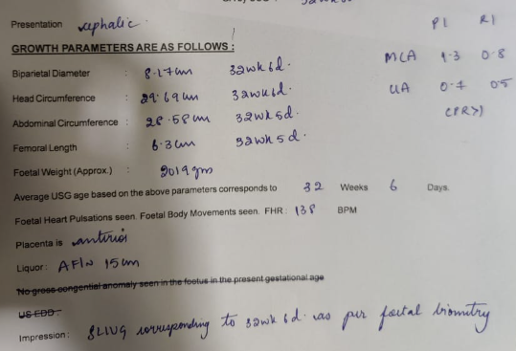
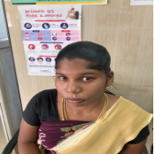
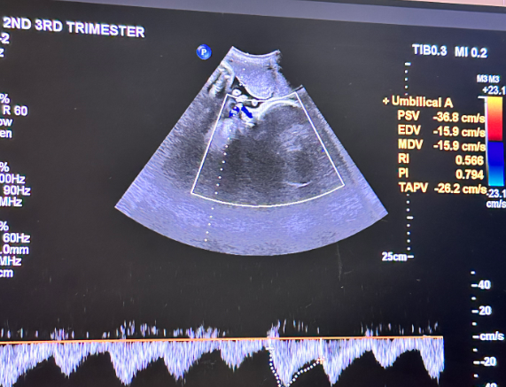
Student Name: BALARAM.S
A case of antenatal checkup
Reg. no: 112001035
S.no: 4 PID: 23050985849
Name: Lakshmi G Age: 23 Gender: Female
Brief Clinical History:
Chief Complaint: Patient came for antenatal routine checkup
History of Presenting Illness: G2P1L1/prev LSCS/ 31 weeks + 6 days/ came for safe confinement . Perceives fetal movements well. No h/o abdominal pain, bleeding pv, leaking pv. No h/o burning micturition, white discharge pv,decreased urine output. No h/o fever, cough, breathlessness. No h/o headache, epigastric pain or blurring of vision.
Past Medical History: h/o previous LSCS was done. No h/o TB, seizure, GDM, hypertension
Workup:
BP-100/60mmHg,RR-16/min,Sp02-97%, pulse=78/min
General examination: Normal
Patient was consciouss and oriented to time, place and person
CVS EXAMINATION: S1S2 heard
RS EXAMINATION: NVBS, trachea appears to be in midline
ABDOMEN EXAMINATION-:
INSPECTION SHAPE OF ABDOMEN: Longitudinally enlarged, SKIN OVER ABDOMEN: Linea Nigra,
PALPATION: FUNDAL GRIP: BREECH, RIGHT UMBILICAL GRIP: LIMB BUDS, LEFT UMBILICAL GRIP: SPINE, FIRST PELVIC GRIP: CEPHALIC
SECOND PELVIC GRIP: Unengaged
LOCAL EXAMINATION : Uterus term, relaxed, cephalic, FH+ 140bpm, spt scar+, no scar tenderness
Examination of thyroid: Normal
Examination of breast : Normal
Differential diagnosis / Clinical insights :
Pyelonephritis
Cholecystitis
Fibroid degeneration
Concealed haemorrhage
Management / Procedure done:
Patient was advised to take growth scan
CBC was done which shows hb: 11.5mg/dl
Tab.Livoden OD for 2 weeks
Tab. Calcium OD for 2 weeks
TAB. CEFOTAXIM 200 mg P/O BD
TAB.PANTOPRAZOLE 40 MG P/O OD
TAB. PARACETAMOL 500 MG TDS
3 |
Page
SAVEETHA MEDICAL COLLEGE HOSPITAL

Slide 8
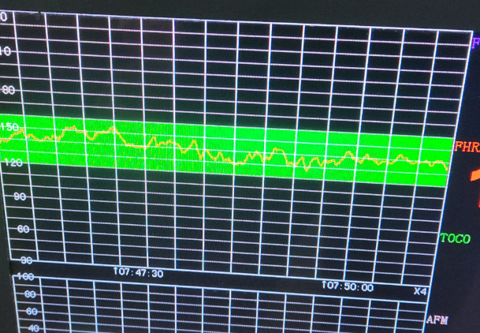
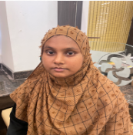
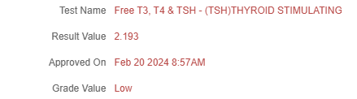
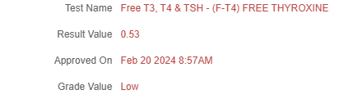
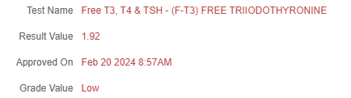
Student Name: BALARAM.S
A case of hypothyroidism in pregnancy
Reg. no: 112001035
S.no: 5 PID: 230715109270
Name: Munniyappan K Age: 25 Gender: Female
Brief Clinical History:
Chief Complaint: Patient came for ANC checkup, G3A2 gestation period =30 weeks 0 days
History of Presenting Illness: Patient came for ANC checkup, G3A2 gestation period =30 weeks 0 days, LMP= 6/6/24. No h/o bleeding p/v, abdominal pain , h/o burning micturition, white discharge pv,decreased urine output
Past Medical History: Patient is a known case of hypothyroidism. No h/o hypertension, TB, GDM, seizure.
Workup:
BP-100/60mmHg,RR-16/min,Sp02-97%, pulse=78/min
General examination: Normal
Patient was consciouss and oriented to time, place and person
CVS EXAMINATION: S1S2 heard
RS EXAMINATION: NVBS, trachea appears to be in midline
ABDOMEN EXAMINATION-:
INSPECTION SHAPE OF ABDOMEN: Longitudinally enlarged, SKIN OVER ABDOMEN: Linea Nigra,
PALPATION: FUNDAL GRIP: BREECH, RIGHT UMBILICAL GRIP: LIMB BUDS, LEFT UMBILICAL GRIP: SPINE, FIRST PELVIC GRIP: CEPHALIC
SECOND PELVIC GRIP: Unengaged
LOCAL EXAMINATION : Uterus corresponding to 28-30 weeks , relaxed , cephalic , FH - 136 bpm
Examination of thyroid: Normal
Examination of breast : Normal
Differential diagnosis / Clinical insights :
Pyelonephritis
Cholecystitis
Fibroid degeneration
Concealed haemorrhage
Management / Procedure done:
Patient was advised to take USG growth AFI doppler , TFT
USG growth doppler shows SLIUG corresponding to 29w 5d as per fetal biometry. Presentation- cephalic CPR>1 FHR- 146 g Fetal weight- 1452 g Placenta- anterior AFI- 16 cm
TFT shows low T3, T4 levels
Tab. Iron 100mg BD for 2 weeks
Tab. Calcium 500mg OD for 2 weeks
3 |
Page
SAVEETHA MEDICAL COLLEGE HOSPITAL

Slide 9
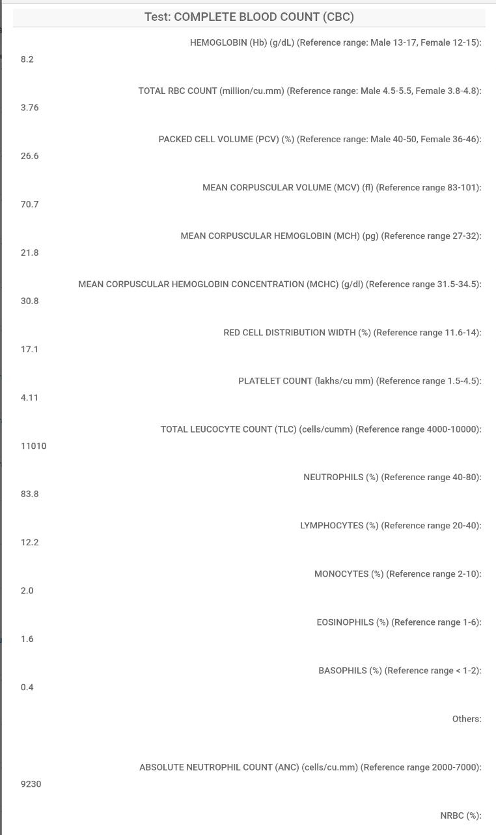
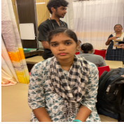
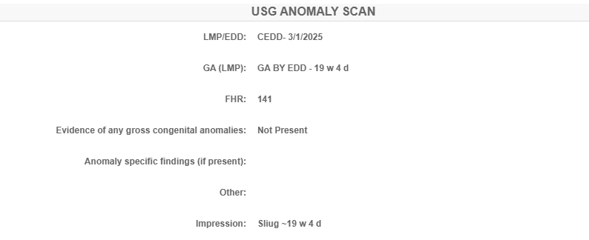
Student Name: BALARAM.S
A case of antenatal checkup
Reg. no: 112001035
S.no: 6 PID: 240627219538
Name: Joshna K Age: 21 Gender: Female
Brief Clinical History:
Chief complaints: 21 yr old primigravida with 5 months of amenorhea came for antenatal checkup, LMP= 17/3/24, 21 weeks 1 day, primigravida,
H/O Presenting Illness: Patient came for antenatal checkup, LMP= 17/3/24, primigravida. No h/o bleeding p/v, abdominal pain , h/o burning micturition, white discharge pv,decreased urine output.
Past History: No history of GDM, TB, thyroid disorder, hypertension
Workup:
BP-98/82mmHg,RR-16/min,Sp02-97%, pulse=78/min,, Ht= 167cm, Weight= 52kg
General examination: Normal
Patient was consciouss and oriented to time, place and person
CVS EXAMINATION: S1S2 heard
RS EXAMINATION: NVBS, trachea appears to be in midline
ABDOMEN EXAMINATION-:
INSPECTION SHAPE OF ABDOMEN: Longitudinally enlarged, SKIN OVER ABDOMEN: Linea Nigra,
PALPATION: FUNDAL GRIP: BREECH, RIGHT UMBILICAL GRIP: LIMB BUDS, LEFT UMBILICAL GRIP: SPINE, FIRST PELVIC GRIP: CEPHALIC
SECOND PELVIC GRIP: Unengaged
LOCAL EXAMINATION :Uterus corresponds to 20- 22 weeks, relaxed, FHS 140
=
Examination of thyroid: Normal
Examination of breast : Normal
Differential diagnosis / Clinical insights :
Pyelonephritis
Cholecystitis
Fibroid degeneration
Concealed haemorrhage
Management / Procedure done:
Patient was advised to take CBC to check for Hb and anomaly scan was done
Hb : 8.2 mg/dl and anomaly scan shows no gross congenital anomalies
Tab. LIVOGEN OD
Tab. Calcium 500mg OD
Patient was advised to do OGTT, as well as CBC on next follow up
3 |
Page
SAVEETHA MEDICAL COLLEGE HOSPITAL

Slide 10
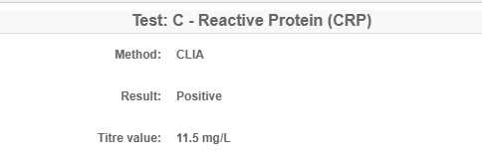
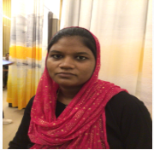
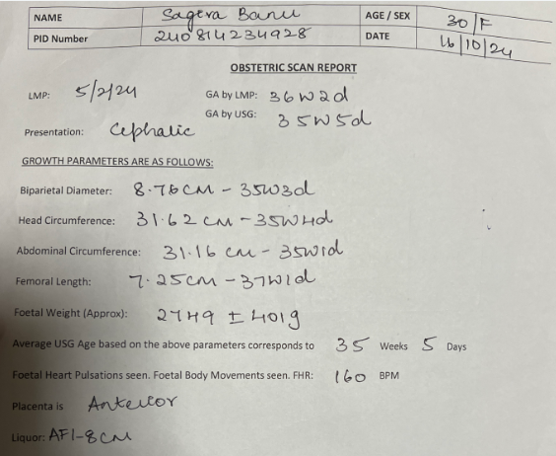
Student Name: BALARAM.S
A case of RH negative pregnancy
Reg. no: 112001035
S.no: 7 PID: 240703221776
Name: Sagira Banu Age: 30 Gender: Female
Brief Clinical History:
CHIEF COMPLAINTS: 30 yrs G3P2L2 with 9 months of amenorrhea (37 weeks 5 days) came for safe confinement.
HISTORY OF PRESENTING COMPLAINTS: Patient came for safe confinement. H/o Lower back pain aggravated on walking, slight abdominal pain since 3days. . No h/o bleeding p/v, h/o burning micturition, white discharge pv,decreased urine output.
Past History: History of thyroid disorder present. No h/o hypertension, TB, GDM.
Workup:
BP-98/82mmHg,RR-16/min,Sp02-97%, pulse=78/min,, Ht= 167cm, Weight= 52kg
General examination: Normal
Patient was consciouss and oriented to time, place and person
CVS EXAMINATION: S1S2 heard
RS EXAMINATION: NVBS, trachea appears to be in midline
ABDOMEN EXAMINATION-:
INSPECTION SHAPE OF ABDOMEN: Longitudinally enlarged, SKIN OVER ABDOMEN: Linea Nigra,
PALPATION: FUNDAL GRIP: BREECH, RIGHT UMBILICAL GRIP: SPINE, LEFT UMBILICAL GRIP: LIMB BUDS, FIRST PELVIC GRIP: CEPHALIC
SECOND PELVIC GRIP: Unengaged
LOCAL EXAMINATION :uterus at term, relaxed ,cephalic FHS + 146 bpm , head 5/5th palpable
=
Examination of thyroid: Normal
Examination of breast : Normal
Differential diagnosis / Clinical insights :
Erythroblastosis fetalis
Hydrops fetalis
Microangiopathic hemolytic anemia
Spherocytosis
Alpha thalassemia
Management / Procedure done:
Patient was admitted and routine investigations were done
CBC shows hb: 12.6
CRP shows 11.5mg/l (HIGH)
LLP/FKC/FHR monitoring, normal diet,plenty of oral fluids
Tab. Livogen od
Tab. Calcium 500mg od
Tab. Thyronorm 25mcg
3 |
Page
SAVEETHA MEDICAL COLLEGE HOSPITAL

Slide 11
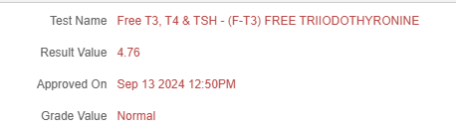
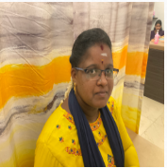
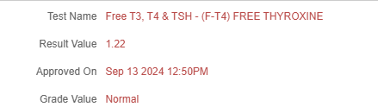
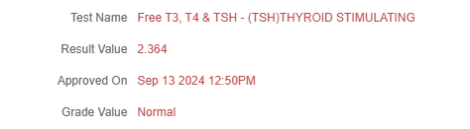
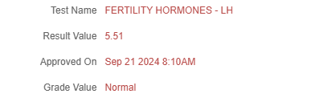
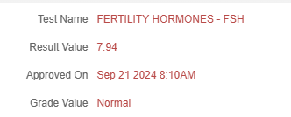
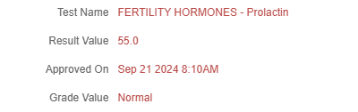
Student Name: BALARAM.S
A case of primary infertility, irregular cycles
Reg. no: 112001035
S.no: 8 PID: 240821236832
Name: Gayathri K Age: 25 Gender: Female
Brief Clinical History:
CHIEF COMPLAINTS: Patient came for review of irregular menstrual cycle, 3-4 / 2-3 months cycle.
HISTORY OF PRESENTING COMPLAINTS: Patient came for review of irregular menstrual cycle. H/o giddiness, tremor present. No h/o abdomen pain, fever, nausea, vomiting, burning micturition, white discharge pv,decreased urine output.
Past History: H/o irregular periods for past 2 years. No h/o T2DM, hypertension, TB, TB CONTACT, thyroid disorder
Personal History: Normal sleep, normal bowel and bladder movements, mixed diet .
Workup:
BP-126/82mmHg,RR-16/min,Sp02-97%, pulse=78/min,,
General examination: Normal
Patient was consciouss and oriented to time, place and person
CVS EXAMINATION: S1S2 heard
RS EXAMINATION: NVBS, trachea appears to be in midline
CNS examination: NFND, no loss of sensation
PER ABDOMEN: Soft,non tender
PER SPECULUM EXAMINATION: Cervix and vagina healthy, mild bleeding through os +
PER VAGINAL EXAMINATION: Cervix pointing downwards, uterus anteverted, normal size, b /l fornices free, non tender
Examination of thyroid: Normal
Examination of breast : Normal
Differential diagnosis / Clinical insights :
Polycystic ovary syndrome (PCOS)
Thyroid disorders
Premature ovarian failure
Endometriosis
Pelvic inflammatory disease (PID)
Management / Procedure done:
Patient was advised to do TFT, FERTILITY HORMONE TEST and review with reports
TFT shows normal thyroid hormones
LH, FSH are normal
Tab Meprate 10mg bd for 5 days
OVRAL-L
3 |
Page
SAVEETHA MEDICAL COLLEGE HOSPITAL

Slide 12
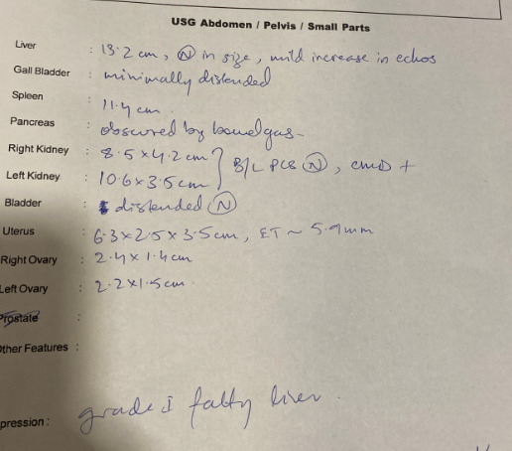
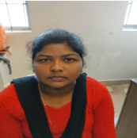
Student Name: BALARAM.S
A case of polycystic ovarian disease
Reg. no: 112001035
S.no: 9 PID: 230912128766
Name: Rajalakshmi S Age: 25 Gender: Female
Brief Clinical History:
CHIEF COMPLAINTS: C/o irregular periods for past 6 months
History of Presenting Illness: C/o irregular periods for past 6 months, periods was earlier seen once in 3 months, h/o back pain is seen, h/o weight gain( is seen , h/o hair fall, fatigue , nausea. No h/o fever, headache, loss of appetite. Irregular cycles LMP 9/6/2024 , complaints of dysmenorhea 2 to 3 pads per day, complaints of passage of clots and dysmennorhea
Past Medical History: Hypothyroid for past 1 year. No h/o T2DM, hypertension, TB, seizure.
Family History: Father is a known case of T2DM
Workup:
BP-126/82mmHg,RR-16/min,Sp02-97%, pulse=78/min,,
General examination: Normal
Patient was consciouss and oriented to time, place and person
CVS EXAMINATION: S1S2 heard
RS EXAMINATION: NVBS, trachea appears to be in midline
CNS examination: NFND, no loss of sensation
PER ABDOMEN- INSPECTION: sphrrical shape, no scars, sinus. PALPATION: Soft non tender
PER SPECULUM EXAMINATION: Not willing
PER VAGINAL EXAMINATION: Not willing
Examination of thyroid: Normal
Examination of breast : Normal
Differential diagnosis / Clinical insights :
Hyperprolactinemia
Hypothyroidism
Congenital adrenal hyperplasia
Pituitary tumors
Ovarian malignancies
Management / Procedure done:
Patient was advised to take USG
USG abdomen shows normal ovary
Lifestyle modifications: low glycemic diet (upto 1500 Kcal/day), physical activity (>150 minutes)
Tab.meprate 10mg bd
Tab. Trapic 50mg TDS
3 |
Page
SAVEETHA MEDICAL COLLEGE HOSPITAL

Slide 13
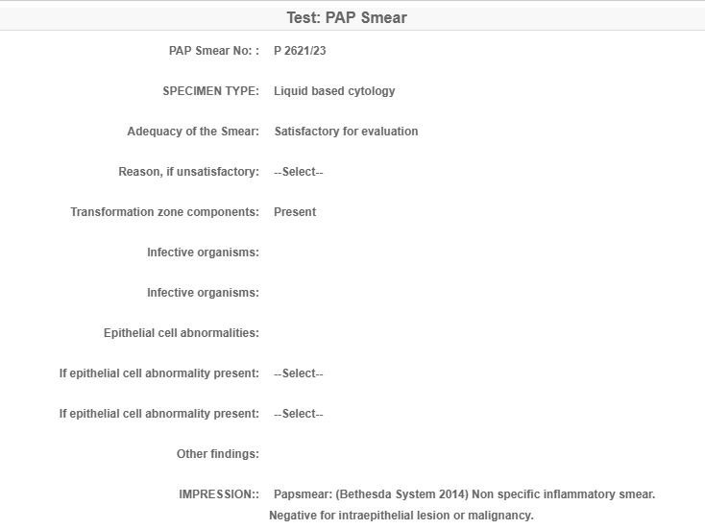
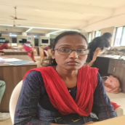
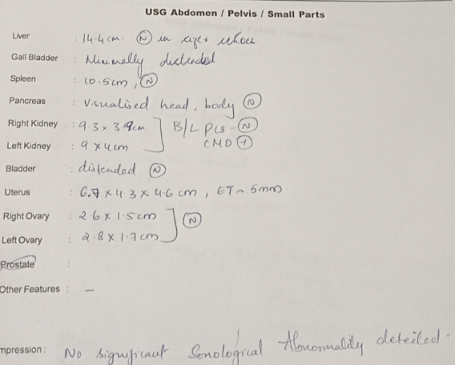
Student Name: BALARAM.S
A case of UTI
Reg. no: 112001035
S.no: 10 PID: 22120328581
Name: SHILPA R Age: 35 Gender: Female
Brief Clinical History:
Chief Complaint: Itching on the genital region with white discharge for past 1 month, LMP=5/9/23, P1L1A1
History of Presenting Illness: Itching on the genital region with white discharge for past 1 month, LMP=5/9/23, h/o hip pain , tiredness, weakness is seen. H/o normal menstruation is seen
No h/o fever, nausea, vomiting.
Past Medical History: Patient came for arthritis in past month
No h/o T2DM, TB, seizure, hypertension, thyroid disorder.
Workup:
BP-116/82mmHg,RR-16/min,Sp02-97%, pulse=78/min,,
General examination: Normal
Patient was consciouss and oriented to time, place and person
CVS EXAMINATION: S1S2 heard
RS EXAMINATION: NVBS, trachea appears to be in midline
CNS examination: NFND, no loss of sensation
PER ABDOMEN- INSPECTION: Umblicus midline; PALPATION: Soft non tender
PER SPECULUM EXAMINATION: Cervix and Vagina healthy
PER VAGINAL EXAMINATION: Cervix pointing downwards Uterus normal size Anteverted B/L fornices free non tender
Examination of thyroid: Normal
Examination of breast : Normal
Differential diagnosis / Clinical insights :
Sexually transmitted infections
Candidal infection
Genitourinary tuberculosis
Urethritis
Urolithiasis
Management / Procedure done:
Patient was advised to take PAP smear, urine complete examination, blood glucose level, USG abdomen
Pap smear shows Non specific inflammatory smear. Negative for intraepithelial lesion or malignancy.
Blood glucose level shows increased FBS: 102 mg/dl, PPBS: 165mg/dl
Candida cream for 3 days
Cansoft CL
3 |
Page
SAVEETHA MEDICAL COLLEGE HOSPITAL

Slide 14
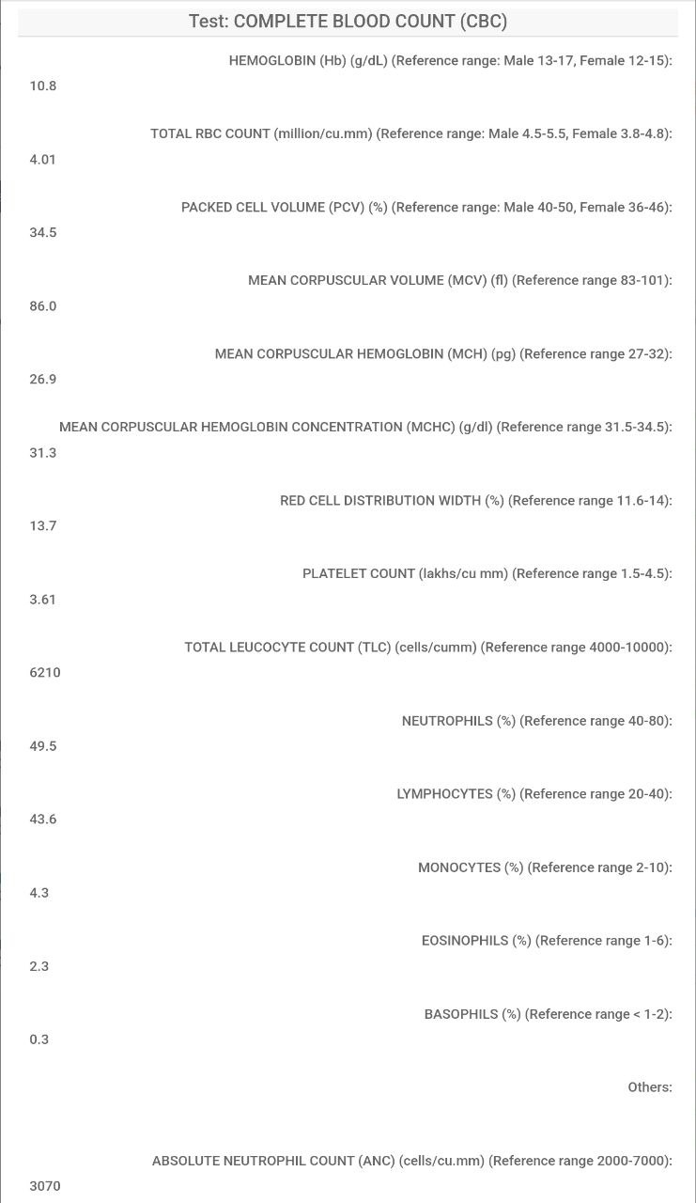
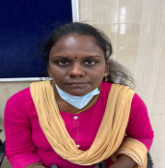
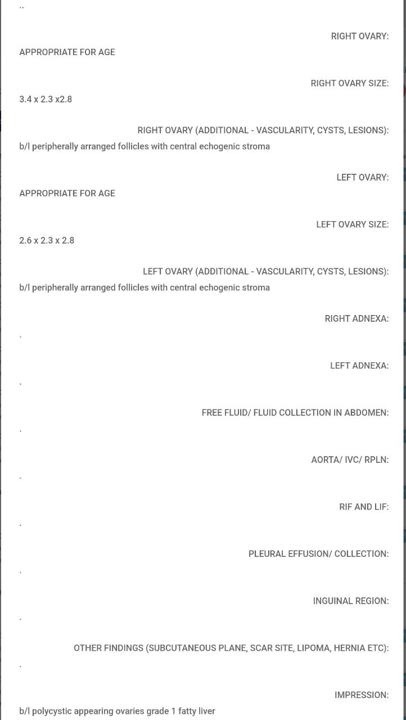
Student Name: BALARAM.S
A case of abnormal uterine bleeding
Reg. no: 112001035
S.no: 11 PID: 23022059862
Name: Manimagalai R Age: 33 Gender: Female
Brief Clinical History:
Chief Complaint: P2L2A1/ prev nvd /Bleeding for past 1 month
History of Presenting Illness: Bleeding for past 1 month, insidious in onset, aggregating on not taking medicines and relived on taking medicines. History of weakness, tiredness, dizziness, change of 3 pads per day. No h/o fever, nausea, vomiting, burning micturition, white discharge pv,decreased urine output.
MENSTRUAL HISTORY: Irregular, AUB since 1 month (LMP 11/8/24) , from 11/8 to 21/8/24 usage of 1 pad/ day, minimal bleeding, blackish discharge , since 21/8 usage of 3 pads/day, fully soaked, passage of clots +, dysmenorrhea +.
Workup:
BP-116/82mmHg,RR-16/min,Sp02-97%, pulse=78/min,,
General examination: Normal
Patient was consciouss and oriented to time, place and person
CVS EXAMINATION: S1S2 heard
RS EXAMINATION: NVBS, trachea appears to be in midline
CNS examination: NFND, no loss of sensation
Abdomen examination: Soft, non tender, no organomegaly
PER SPECULUM EXAMINATION: Cervix and vagina healthy Bleeding through os present
PER VAGINAL EXAMINATION:Cervix pointing downwards,uterus anteverted,mobile,b/l fornices free
Examination of thyroid: Normal
Examination of breast : Normal
Differential diagnosis / Clinical insights :
Ectopic pregnancy
Placental polyp
Infection, such as chlamydia, gonorrhea, or trichomoniasis
Benign pelvic lesions, such as polyps or fibroids
Endometriosis, adenomyosis, or leiomyomas
Management / Procedure done:
Patient was advised to do CBC, USG abdomen and pelvis
CBC shows Hb: 10.8mg/dl
USG abdomen shows b/l polycystic appearing ovaries grade 1 fatty liver
Tab.TRANEXAMIC ACID TDS for 5 days
3 |
Page
SAVEETHA MEDICAL COLLEGE HOSPITAL

Slide 15
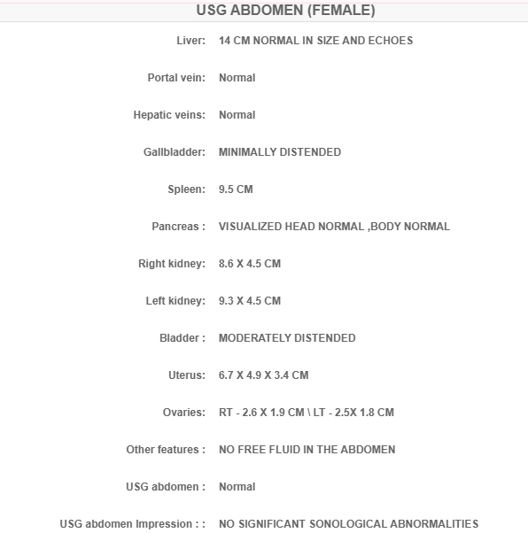
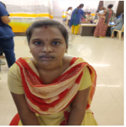
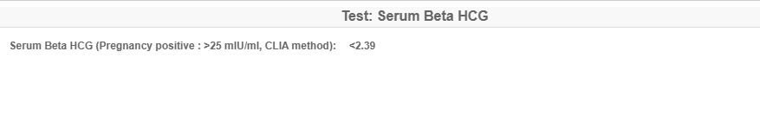
Student Name: BALARAM.S
A case of amenorrhea
Reg. no: 112001035
S.no: 12 PID: 231114150538
Name: Visalakshi A Age: 20 Gender: Female
Brief Clinical History:
Chief Complaint: Ammenorhea for past 40 days LMP= 17/8/24
History of Presenting Illness: Ammenorhea for past 40 days. UPT negative, no h/o tiredness, dizziness, weakness, pain, weight loss, fever, nausea, vomiting, burning micturition, white discharge pv,decreased urine output.
Past Medical History: Similar complaints were seen in 4months back
MENSTRUAL HISTORY:Regular,3/30,3pads/day,no clots no dysmenorrhea
Family History: No significant history.
Workup:
BP-116/82mmHg,RR-16/min,Sp02-97%, pulse=78/min,,
General examination: Normal
Patient was consciouss and oriented to time, place and person
CVS EXAMINATION: S1S2 heard
RS EXAMINATION: NVBS, trachea appears to be in midline
CNS examination: NFND, no loss of sensation
PER ABDOMEN-
INSPECTION: flat shape, no scar, sinuses
PALPATION: Soft, Non tender
Examination of thyroid: Normal
Examination of breast : Normal
Differential diagnosis / Clinical insights :
Pregnancy
Hyperprolactinemia
Polycystic ovary syndrome (PCOS)
Thyroid disease
Premature ovarian insufficiency (POI)
Management / Procedure done:
Patient was advised to take USG abdomen and serum beta hcg levels
Beta hcg shows normal (<2.39)
USG shows no significant sonological abnormalities
Tab. medroxy progesterone acetate 5mg BD 5 days
3 |
Page
SAVEETHA MEDICAL COLLEGE HOSPITAL

